Slide 1

Data Science Committee
Session 05 - Data Transformation
Prepared by: Ashraf Abdulkhaliq

Slide 2
Outline
Handle Columns Distribution
Data Unity
Data Balancing
Lab

Slide 3
Outline
Handle Columns Distribution
Data Unity
Data Balancing
Lab

Slide 4
Handle Columns Distribution
Explore Distributions: Use visualizations (histograms, box plots, etc.) to understand the distribution of each column.
Dealing with Skewness: Handle skewed distributions, such as log transformations or power transformations, etc ...
Outlier Detection and Treatment: Identify and handle outliers that might affect the distribution.

Slide 5
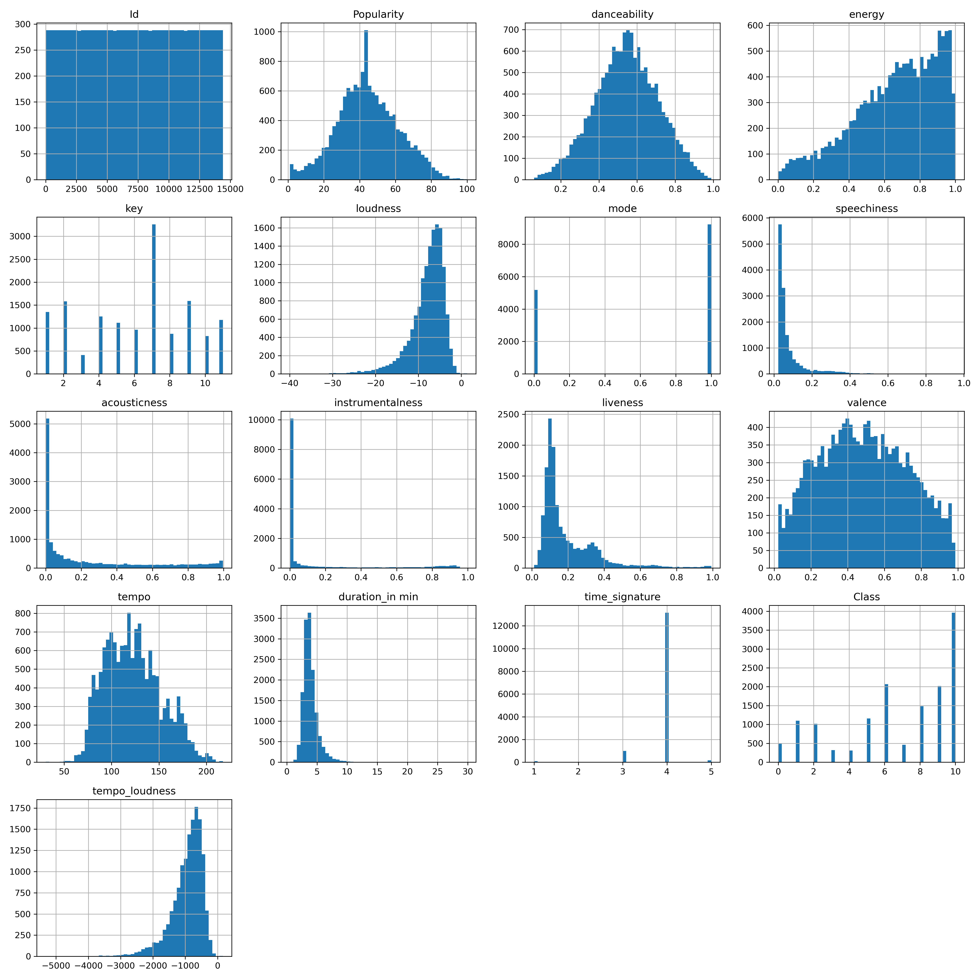
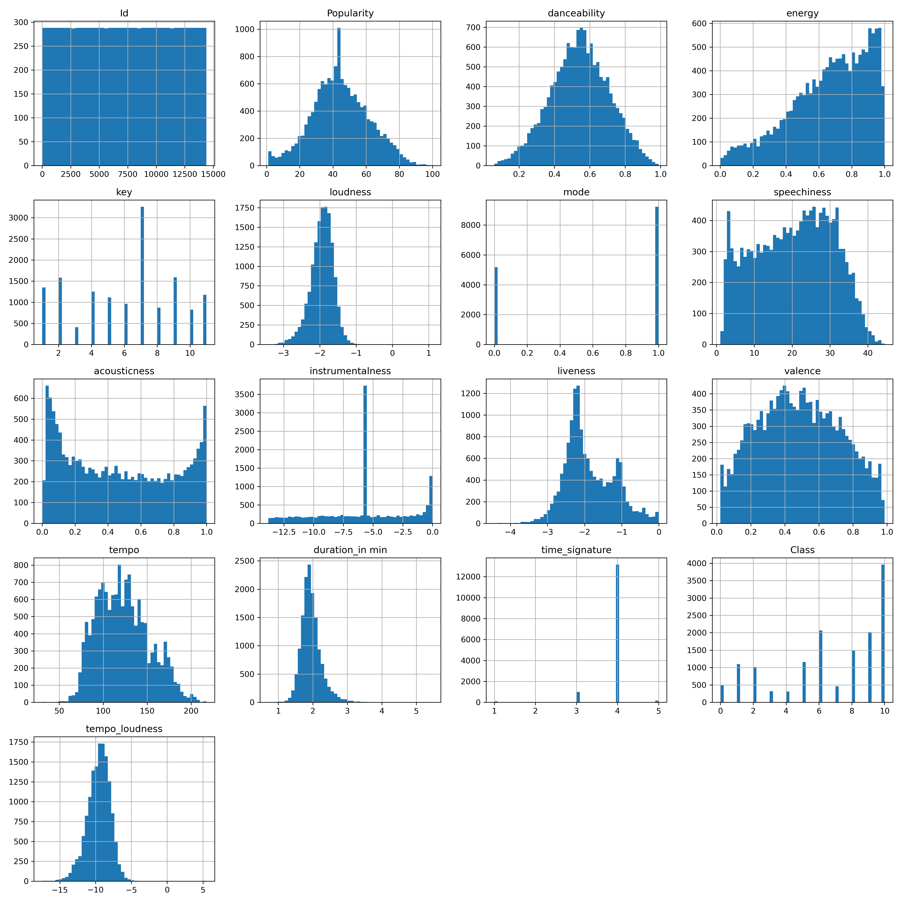
Handle Columns Distribution (cont)
LOG

Slide 6
Handle Columns Distribution (cont)
SQRT

Slide 7
Handle Columns Distribution (cont)
CBRT

Slide 8
Handle Columns Distribution (cont)
CBRT

Slide 9
Handle Columns Distribution (cont)
Reciprocal

Slide 10
Handle Columns Distribution (cont)
CBRT

Slide 11
Handle Columns Distribution (cont)
LOG

Slide 12
Handle Columns Distribution (cont)
CBRT

Slide 13
Outline
Handle Columns Distribution
Data Unity
Data Balancing
Lab

Slide 14
Data Unity
Data Types and Formats: Ensure consistency in data types (numeric, categorical, datetime, etc.) and formats (text, numerical, categorical codes, etc.).
Unit and Scale Consistency: Check if units and scales are consistent across different columns. Normalize or standardize data as needed.
Feature Splitting: Split composite features like full names into first and last names for improved model interpretability.

Slide 15
Outline
Handle Columns Distribution
Data Unity
Data Balancing
Lab

Slide 16
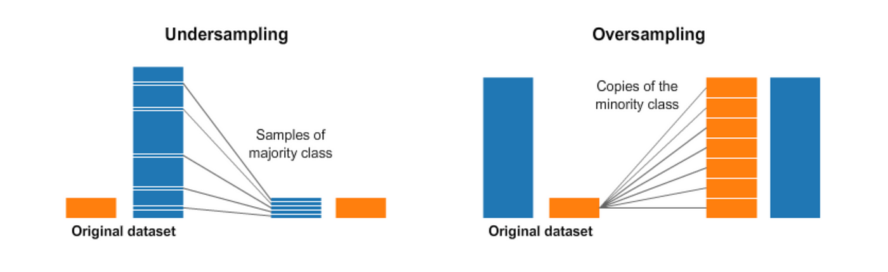
Data Balancing

Slide 17
Outline
Handle Columns Distribution
Data Unity
Data Balancing
Lab

Slide 18
Lab
Open Juypter Notebooks for session 05 to cover this topics in practice:
Handle columns distribution.
Check data formats, data splitting, units, scales, etc...
Data visualization using Seaborn.

Slide 19
References
https://towardsdatascience.com/having-an-imbalanced-dataset-here-is-how-you-can-solve-it-1640568947eb

Slide 20
Thanks
Please keep updated:
https://github.com/kershrita/IEEE-Data-Science

